Slide 1

Customer’s e-Purchasing Intention Analytics
Group 59
Krishna teja Samudrala
Snehal gopal dhone
Presentation date: 04/14/2023

Slide 2
Table of contents
1. Project Selection and Problem Definition
2. Data Collection
3. Data Visualization
4. Data Exploration
5. Preprocessing and Data Preparation
6. Candidate Data Mining Models
7. Model Performance Evaluation
8. Model Interpretation
9. Model Performance Visualization
10. Conclusion
11. Recommendation

Slide 3
1. Project Selection and Problem Definition
Project Selection
Identified and selected the "Online Shoppers Purchasing Intention" project based on its relevance to online retail and availability of a quality dataset from Kaggle.
Considered the project’s potential impact on improving sales and optimizing business strategies for online retailers.
Problem Definition
The project aims to predict online shoppers' purchasing intention using machine learning techniques.
The main problem is to identify the key factors that influence online purchasing intention and provide recommendations to online retailers for improving their sales.
Challenges include dealing with unstructured data, data cleaning and processing, and developing accurate prediction models.
The project also involves interpreting the results and providing actionable insights for optimizing online retail strategies.

Slide 4

2. Data Collection
Data Source
The dataset for this project was obtained from the UCI Machine Learning Repository, specifically from the Center for Machine Learning and Intelligent Systems. This is a reputable source known for its quality datasets used in machine learning and data analysis projects.
Data Description:
The dataset consists of 12,330 rows of information (also known as sessions) and contains 18 features. Out of the 18 features, 10 are numerical and 8 are categorical. The features include variables such as Administrative, Administrative Duration, Informational, Informational Duration, Product Related, Product Related Duration, Bounce Rates, Month, Exit Rates, Page Values, Special Day, Operating Systems, Browser, Region, Traffic Type, Visitor Type, Weekend, and Revenue. These features provide valuable information about user behavior, browsing patterns, and purchase-related activities on the online store.
Data Collection Method
The data was collected through website logs of the online store, capturing various activities of users during their sessions, such as page views, duration, bounce rates, exit rates, and purchase completion. The data was then organized and processed to create a structured dataset that can be used for analysis and modeling

Slide 5
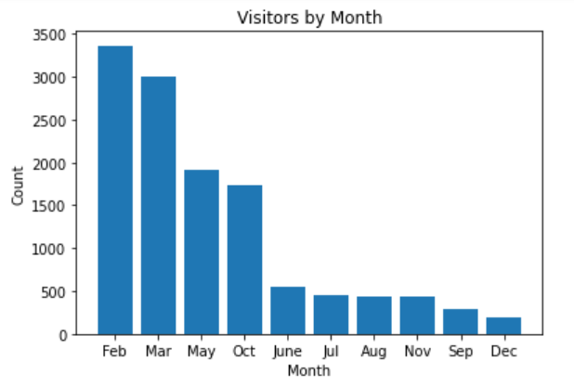
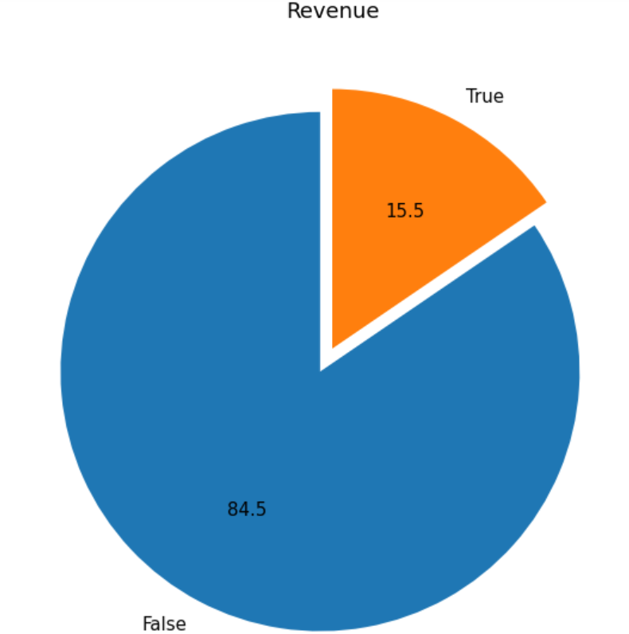
3. Data VIsUALIZATIONS
Revenue Distribution

Slide 6
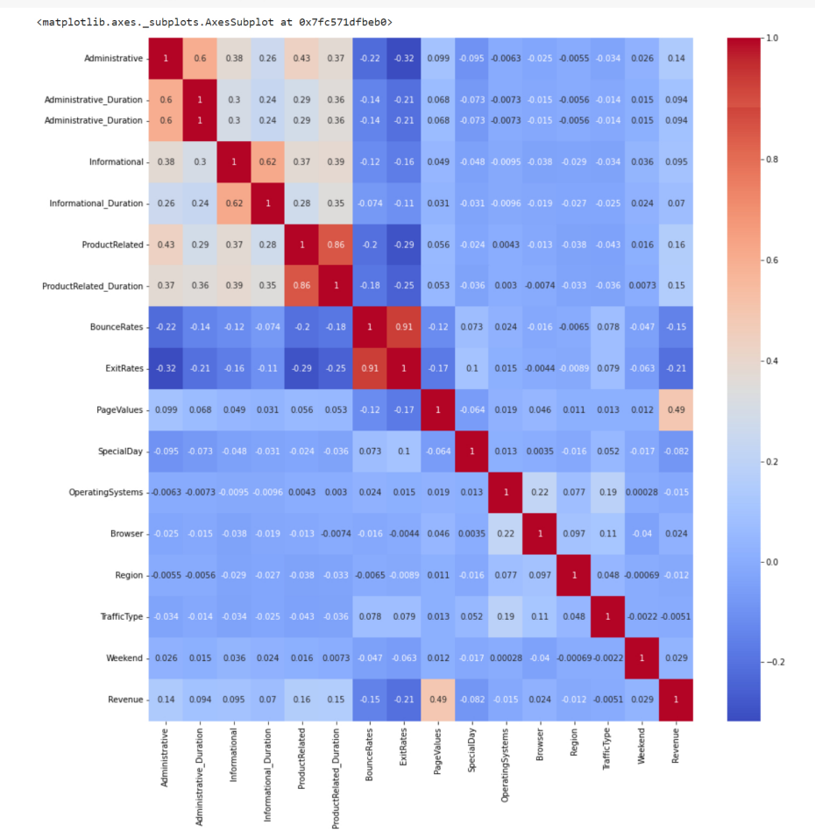
HEATMAP
This plot shows how each feature in the dataset is correlated with every other feature

Slide 7
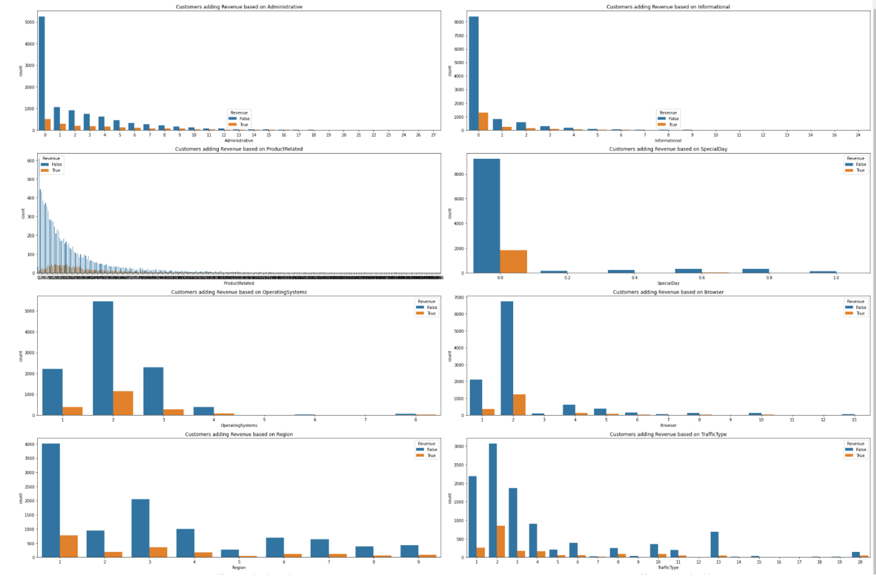
Univariate analysis
Customers adding revenue based on Administrative, Informational, ProductRelated, Special Day, Operating Systems, Browser, Region, and Traffic Type

Slide 8
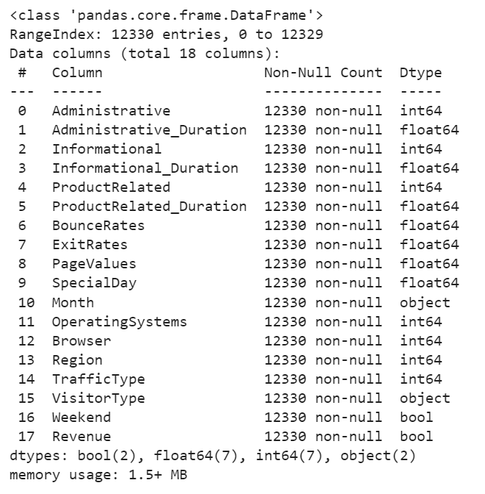
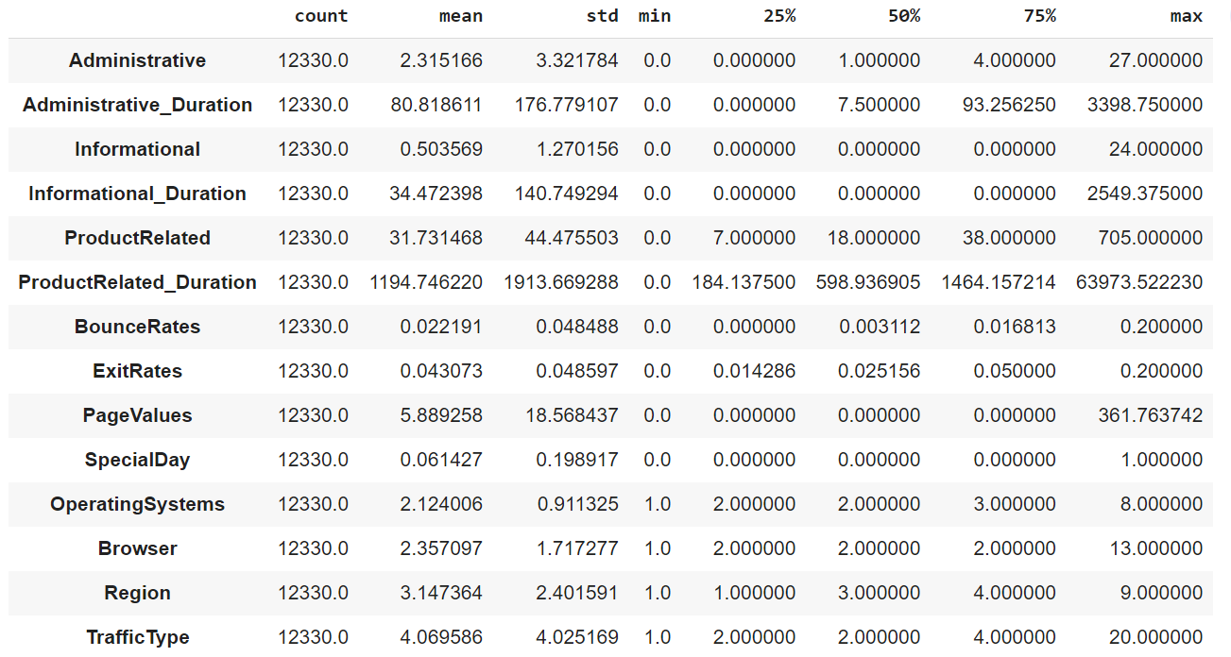
4. Data Exploration
Description and Summary Statistics

Slide 9
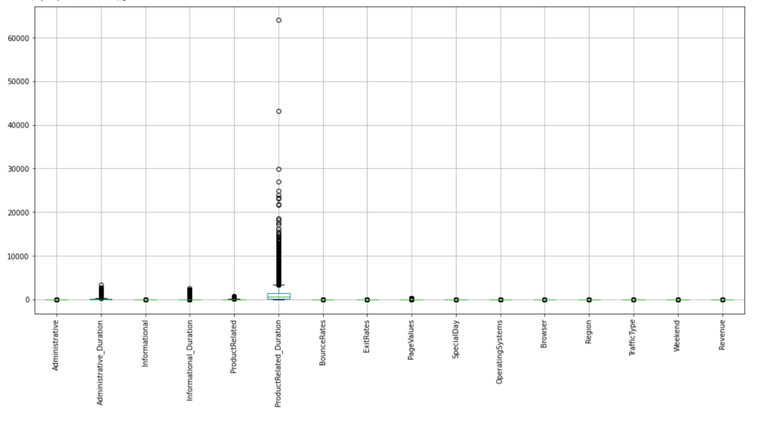
5. Preprocessing and Data Preparation
Preprocessing
Dropped "BounceRates" and "ProductRelated_Duration" columns due to high correlation and lack of relevance for analysis.
Converted categorical variables "Weekend" and "Revenue" into numerical variables for machine learning compatibility.
Dropped "Revenue" column from features dataset X and assigned it to the target variable y using the drop() function.
Encoding
Categorical variables in the dataset: "Month", "Browser", "Region", "TrafficType", "VisitorType", and "Weekend"
Encoding categorical variables into numerical values is necessary for machine learning
Simple methods like .astype(int) and One-hot encoding used in this dataset
LabelEncoder assigns a unique integer to each category, creating an ordering of categories that might not make sense in certain situations
One-hot encoding is more appropriate for categorical variables like "Month" where there is no inherent ordering of categories

Slide 10

SPLITTING INTO TRAINING AND VALIDATION
Divided the dataset into training, validation, and testing sets.
Used 'train_test_split' function from scikit-learn to split data which takes four parameters: X, y, test_size, and random_state.
X contains final dataset with encoded features and y contains target variable i.e. ‘Revenue’.
The final data was divided into 70% training set, 15% validation set, 15% test set.
The training set was further scaled using ‘StandardScaler’ for better performance.

Slide 11

Implementation of SMOTE
Imbalanced datasets are common in e-commerce due to low purchase rates and, so in our project.
Biased models and inaccurate predictions can result from imbalanced data.
SMOTE is used method for handling imbalanced dataset, and creates synthetic samples of minority class by interpolating between existing instances.
Improved dataset balance leads to better machine learning model performance.
Using SMOTE helps to reduce bias in predictions and improve overall accuracy.

Slide 12
6. Candidate Data Mining Models
Logistic Regression
Advantages: Simple and easy to implement, handles binary and multiclass classification, outputs probabilities, can be used as a baseline model
Disadvantages: Assumes linear relationship, sensitive to outliers and multicollinearity
Decision Tree
Advantages: Easy to understand and interpret, handles categorical and numerical data, identifies complex relationships
Disadvantages: Prone to overfitting, sensitive to data changes, can create biased trees
Random Forest
Advantages: Handles categorical and numerical data, identifies complex relationships, handles missing values and outliers, reduces overfitting
Disadvantages: Computationally expensive, difficult to interpret, can create biased trees
Naive Bayes
Advantages: Simple and easy to understand, performs well with high-dimensional data, computationally efficient, handles categorical and continuous data
Disadvantages: Assumes independence among features, may result in poor accuracy, biased towards categorical inputs
XGBoost
Advantages: Highly accurate, handles missing data, optimized for speed, provides built-in regularization, provides feature importance score
Disadvantages: Can overfit data, complex model, requires high computational resources

Slide 13
7. Model Performance Evaluation
Importance of considering multiple metrics
In the evaluation of model performance, it is important to consider multiple metrics rather than relying solely on accuracy. Metrics such as F1 score, MCC, sensitivity, specificity, and ROC AUC score provide a more comprehensive and balanced assessment of the model's performance, especially in the context of imbalanced datasets.
Selection of the best-performing model
Based on the evaluation metrics, the Random Forest model was selected as the best-performing model for the classification problem.
ML Model | Logistic Regression | Decision Tree | Random Forest | Naïve Bayes | XG Boost
Accuracy | 0.869 | 0.869 | 0.901 | 0.746 | 0.887
F1 Score | 0.619 | 0.56 | 0.667 | 0.455 | 0.607
MCC | 0.548 | 0.483 | 0.608 | 0.35 | 0.544
Sensitivity | 0.722 | 0.573 | 0.69 | 0.708 | 0.718
Specificity | 0.891 | 0.923 | 0.927 | 0.753 | 0.917
ROC AUC Score | 0.902 | 0.743 | 0.923 | 0.821 | 0.921

Slide 14
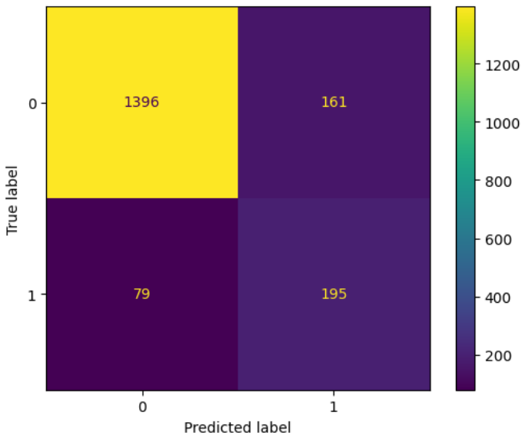
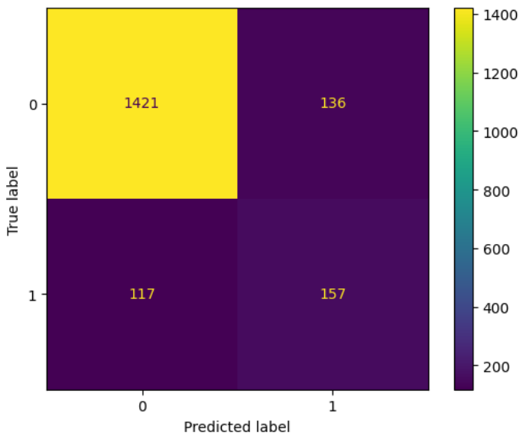
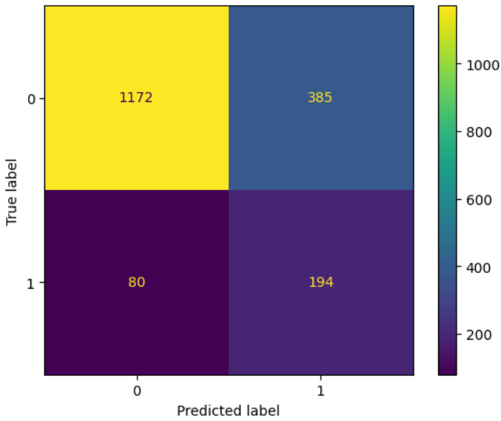
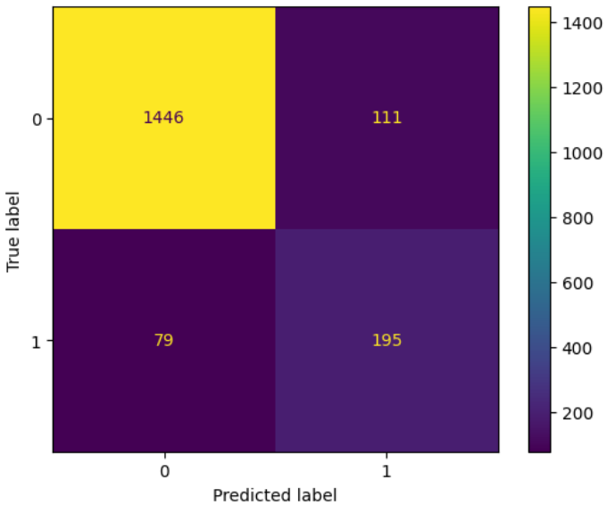
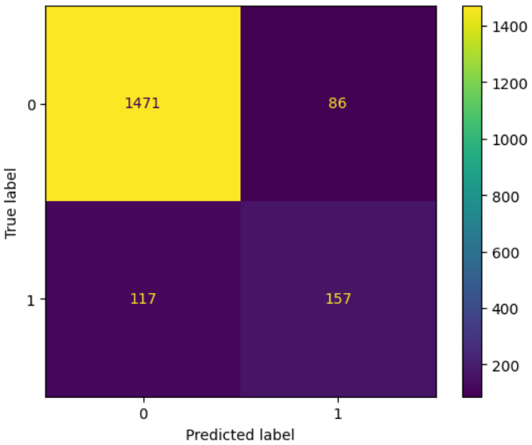
8. Model interpretation
Confusion matrix is a powerful tool for evaluating the performance of a classification model. It provides a detailed breakdown of the model's predictions, helping us understand the accuracy, sensitivity, specificity, precision, recall, and other performance metrics of the model.
Logistic Regression
Decision Tree
Naïve Bayes
Random Forest
XGBoost

Slide 15
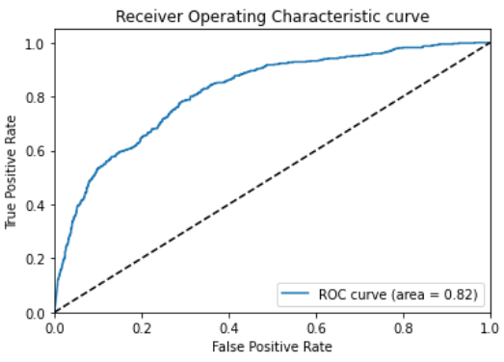
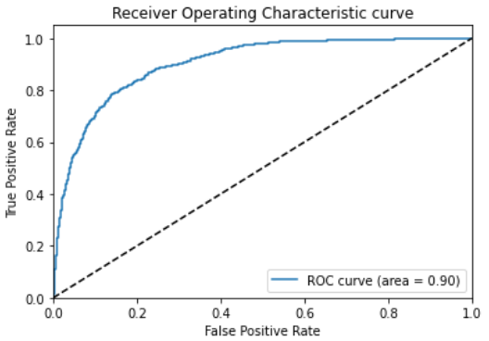
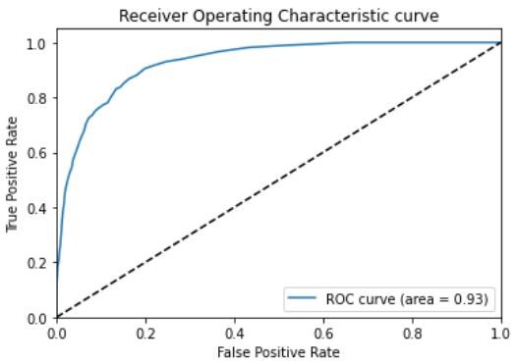
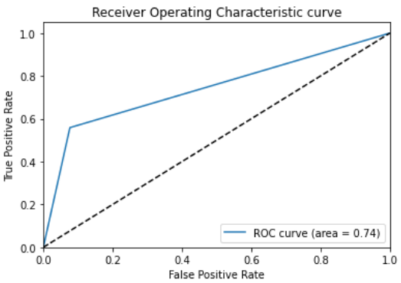
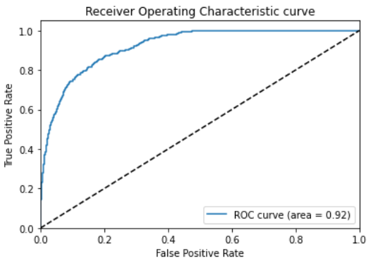
Interpretation of ROC AUC (Receiver Operating Characteristic Area Under the Curve) score
ROC AUC score is a useful metric for evaluating the overall performance of the model in distinguishing between the minority and majority classes. A higher ROC AUC score indicates a better ability of the model to correctly classify instances into their respective classes.
Naïve Bayes
Logistic Regression
Random Forest
Decision Tree
XGBoost

Slide 16
9. Model Performance Visualization

Slide 17
10. Conclusion
Developed robust revenue prediction model using various machine learning algorithms, such as logistic Regression, Decision Tree, Random Forest, Naive Bayes, and XGBoost, by leveraging behavioral parameters.
Demonstrated the importance of exploratory data analysis, data preprocessing, hyperparameter tuning, and appropriate evaluation metrics in improving model performance and ensuring reliability of the results.
Trained five different models to predict revenue range, and found that Random Forest outperformed all other models in terms of accuracy, F1 score, MCC, and ROC AUC score.
Used early stopping and hyperparameter tuning to overcome the overfitting issue and improve the Random Forest model's performance.
Random Forest algorithm is powerful for classification tasks, especially when dealing with imbalanced datasets, and has several benefits such as high accuracy, fast computation, and built-in regularization.
The findings of our study provide valuable insights for businesses to identify potential revenue sources based on customers' behavior and take appropriate actions to increase revenue.

Slide 18
11. recommendations
Give priority to pages with low page values: As page value is the most important feature of the e-commerce site, it is crucial to focus on pages that have low page values and allocate resources accordingly.
Take advantage of revenue opportunities in February and March: According to EDA, survey, and feature importance, February and March are profitable months for generating revenue. To capitalize on this, we can provide holiday gift coupons, goodies, and special discounts (such as the Big Billion Day sale) to customers.
Be mindful of high bounce and exit rates: High bounce and exit rates can adversely impact revenue, so it is important to be cautious when allocating resources to users with such rates.
Prioritize users who spend an appropriate time researching products: Product duration is a significant feature that contributes to the model, thus it is necessary to prioritize users who spend an adequate amount of time researching products (usually between 5000 and 15000 seconds).

